Slide 1

Wrapping up
This work is licensed under the Creative Commons Attribution 2.5 UK: Scotland License.
Notes:
Now that we’ve set the scene for today. We’ll get started on thinking about scoping and refining user requirements.
Without a solid understanding of what users want, it is impossible to develop services that will be used and valued. For the next 20 minutes, we’ll share some tips on how to start assessing user requirements at your institution. We’ve distilled key points from our How to Develop RDM
Services and How to Discover Requirements for Research Data Management Services guides – both are included in your packs so that you can delve into these in more detail once you return home.

Slide 2
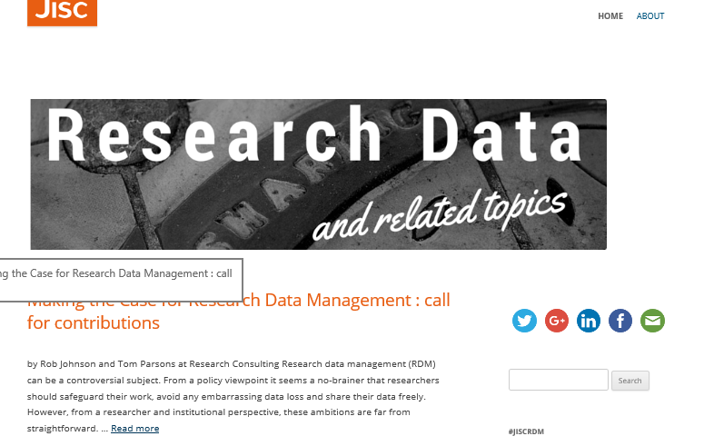
Possible next steps
http://researchdata.jiscinvolve.org/wp/
Notes:
Jisc Research at Risk looking for contributions and case studies

Slide 3
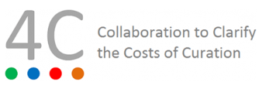
Possible next steps
Notes:
A workshop taking place here at IDCC on possible ways to take forward 4C outputs and roadmap.

Slide 4
Summing up
Understand your organisational context
User requirements need to be gathered and refined over time for each user community
Balance your service offer against resources available and strategic objectives
Re-assess scope as you roll out pilot services - learn through your own experience and from your peers
Contextualise costs when making the business case
Plan to review and revise business model over time

Slide 5
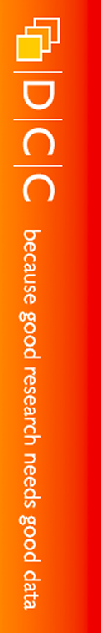
Thanks for listening!
DCC guidance, tools and case studies:
www.dcc.ac.uk/resources
Follow us on twitter:
@digitalcuration and #ukdcc

